Slide 1


Prejudice Tracker

Slide 2
Team Members
Rakhi Kumari
Roll No. -12212083
Section : CS B5
Pooja Meena
Roll No. -12212086
Section : CS B5
Sadhana
Roll No. -12212105
Section : CS B6
Dharna Mittal
Roll No. -12212143
Section : CS B8
Gurleen Kaur
Roll No. -12212145
Section : CS B8

Slide 3


Prejudice Tracker Detection to correction: Fight against prejudice
Ever wished there was a way to spot prejudice as it happens? Well, now there is! Meet the Prejudice Tracker, your trusty tool for detecting and addressing bias in real-time.
Imagine a world where unfair treatment and discrimination are quickly identified and addressed. With the Prejudice Tracker, we're making that vision a reality.
From online conversations to everyday interactions, our cutting-edge platform keeps an eye out for prejudice, helping you understand it and take action. Join us in the fight for equality and inclusivity with the Prejudice Tracker by your side!

Slide 4
MOTIVATION
The motivation for developing the Prejudice Tracker stems from the urgent need to combat prejudice in all its forms. Here are some key sources of motivation:
Social Justice: Prejudice, whether based on race, gender, religion, or any other factor, perpetuates inequality and injustice. By detecting and addressing prejudice, we contribute to creating a fairer and more just society for all.
Human Dignity: Every individual deserves to be treated with dignity and respect. Prejudice undermines this fundamental principle by devaluing people based on irrelevant characteristics. The Prejudice Tracker aims to uphold human dignity by challenging biased attitudes and behaviors.
Psychological Well-being: Prejudice can have detrimental effects on the mental health and well-being of its targets. By actively combating prejudice, we promote psychological resilience and create safer environments for everyone.
Ethical Imperative: It is our moral responsibility to challenge prejudice wherever we encounter it. By developing tools like the Prejudice Tracker, we fulfill our ethical duty to promote equality, justice, and human rights.

Slide 5



Tech Stacks Used

Slide 6
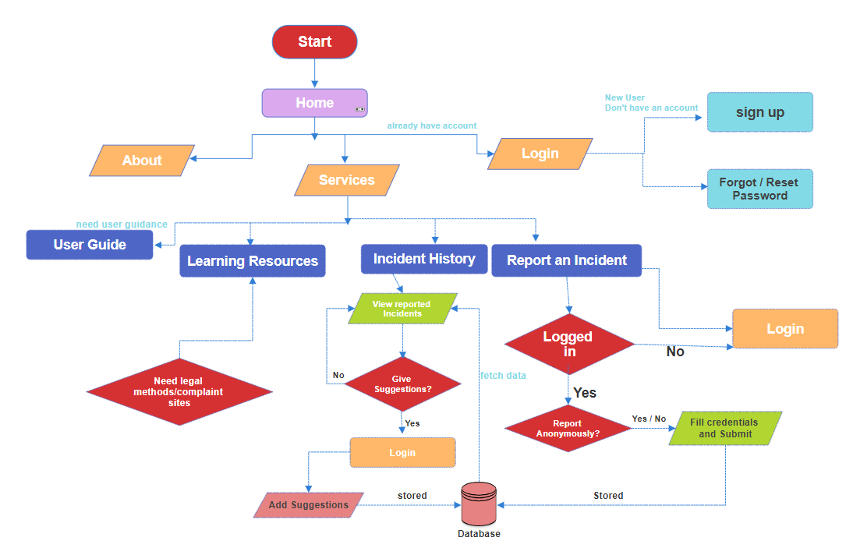
Methodology flow chart

Slide 7
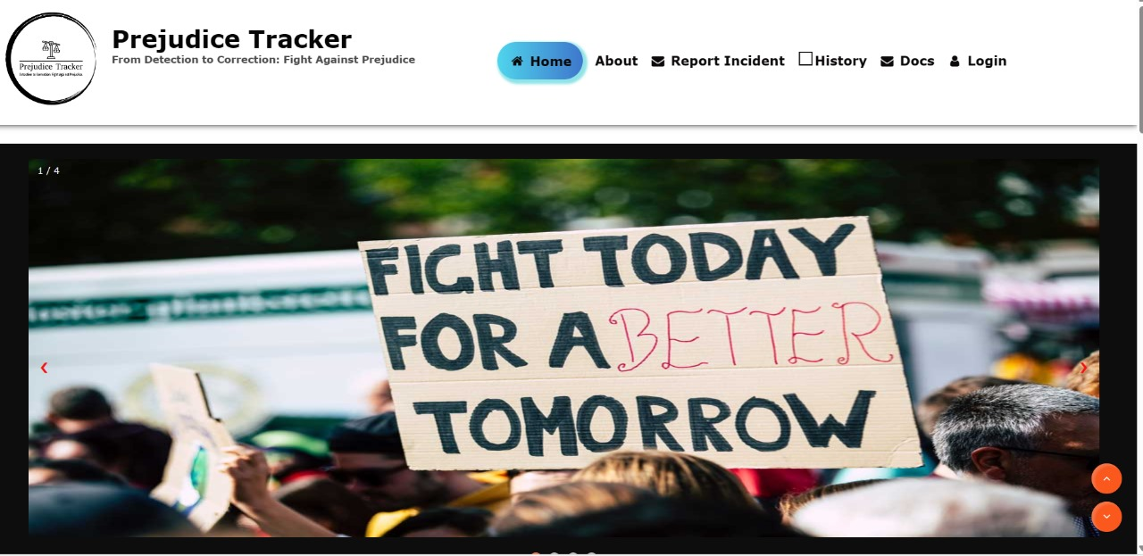
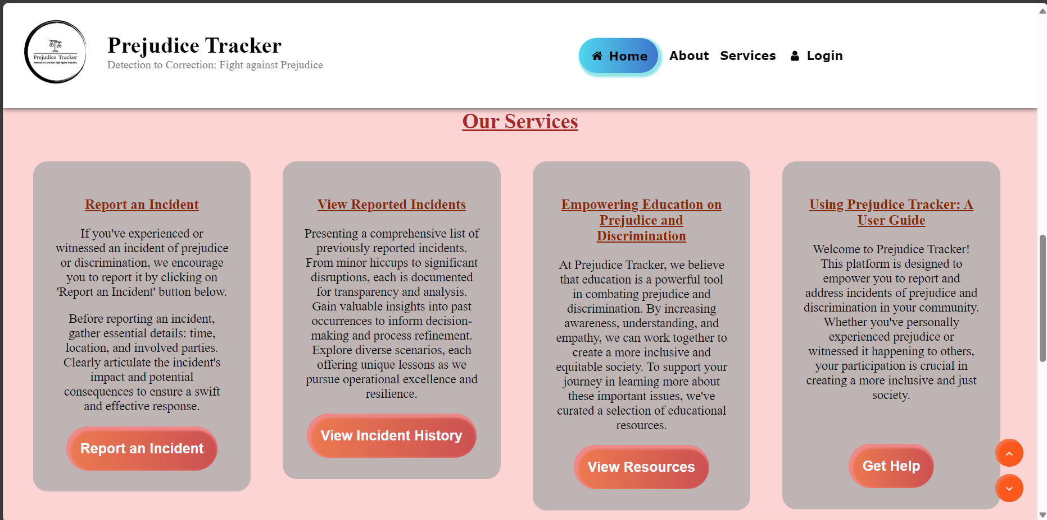
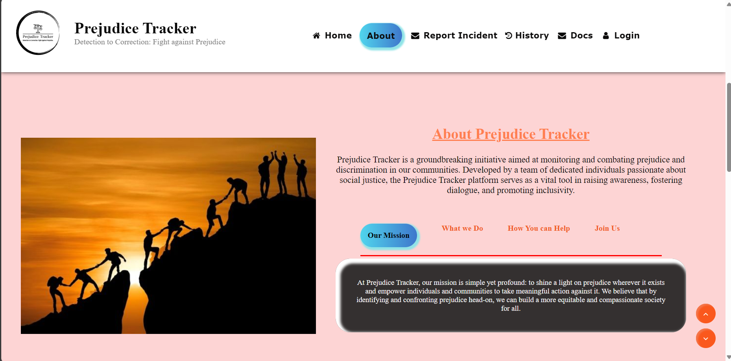
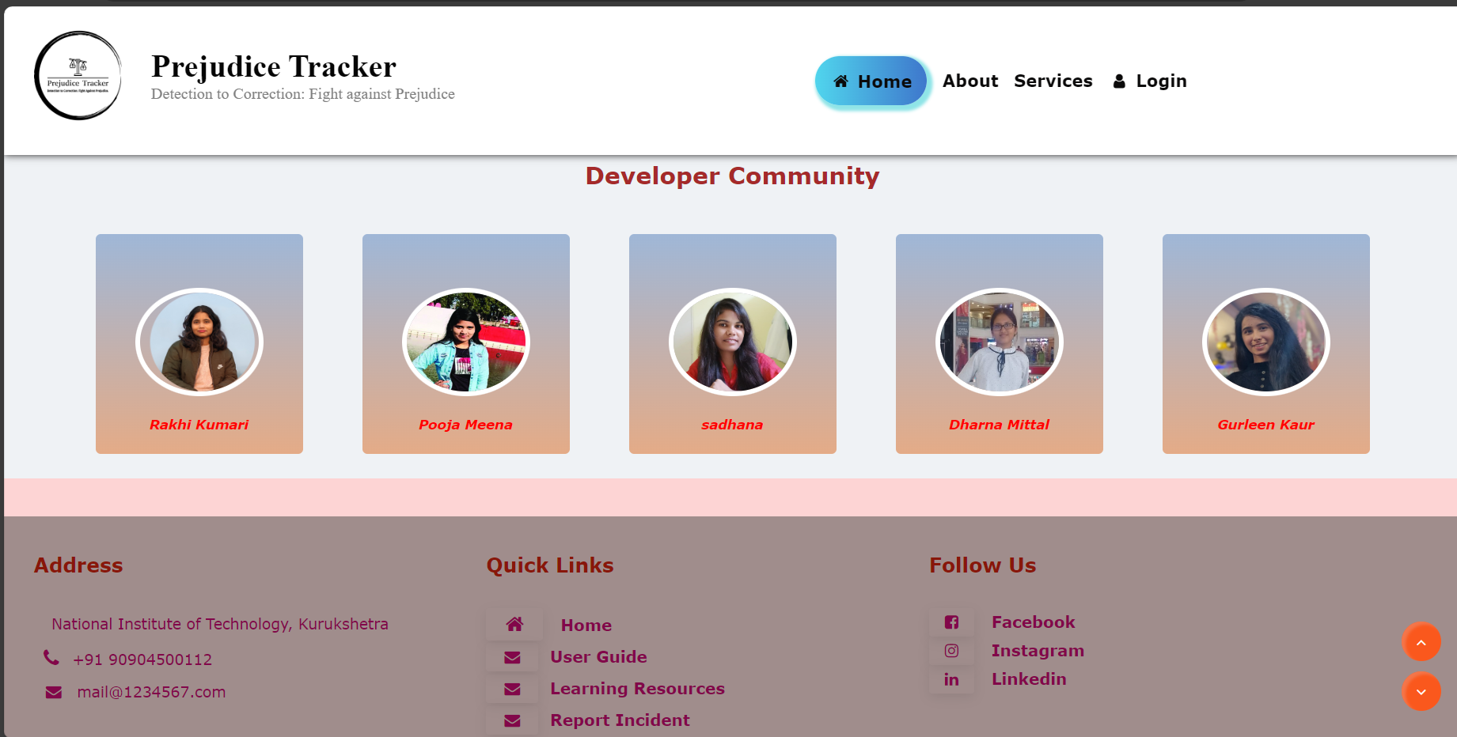
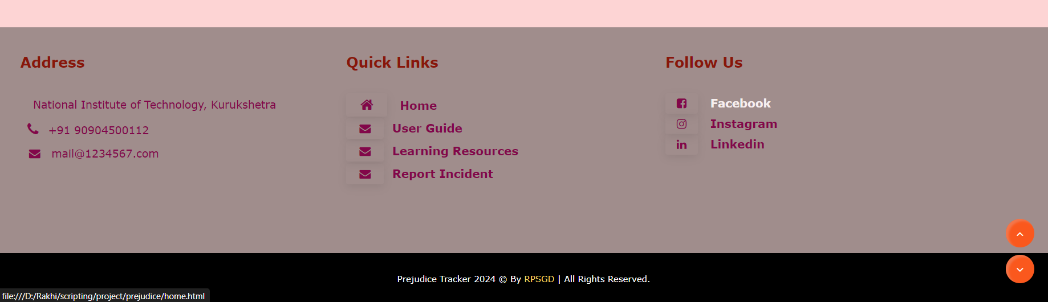
Homepage

Slide 8
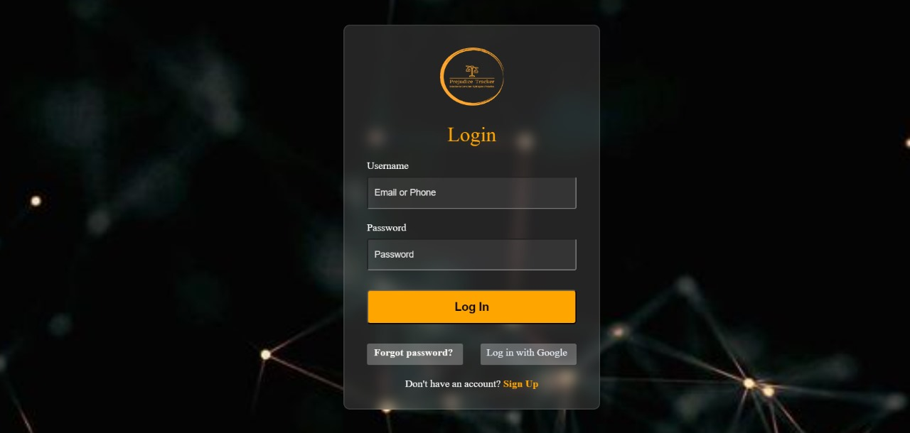
Login

Slide 9
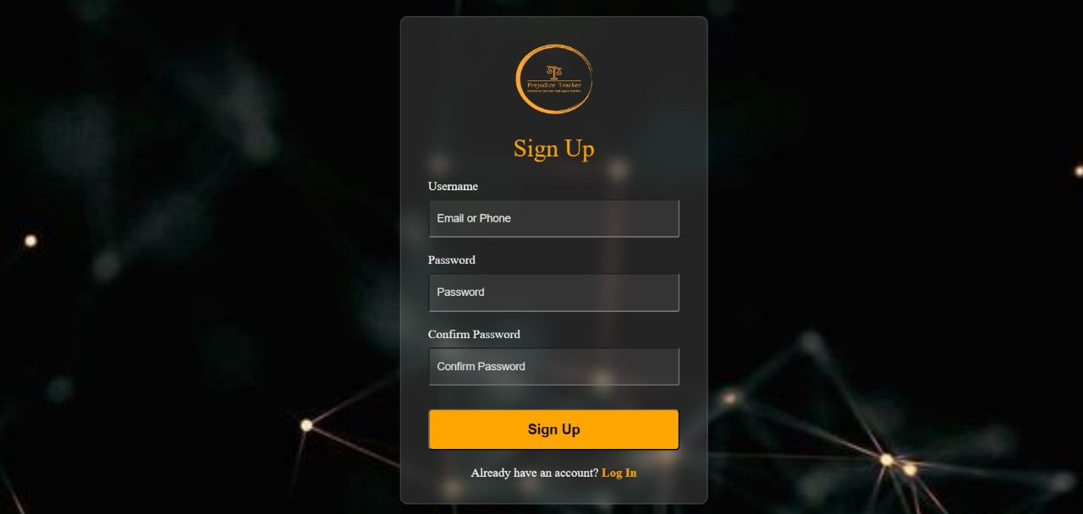
Signup

Slide 10
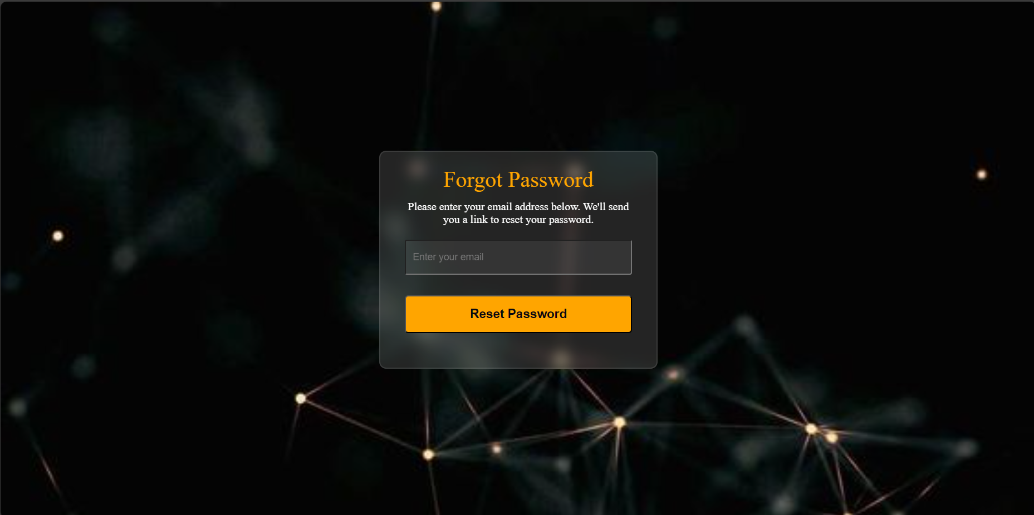
Forgot Password / Reset Password

Slide 11
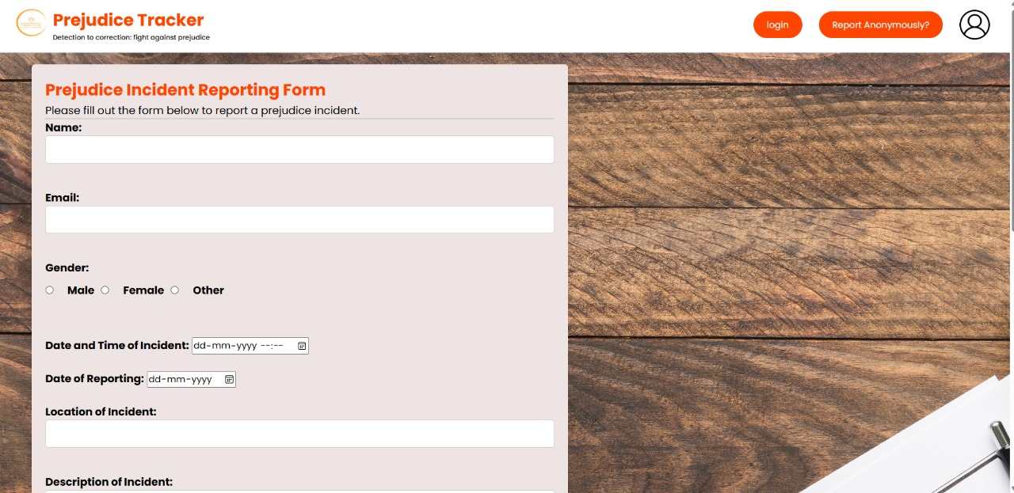
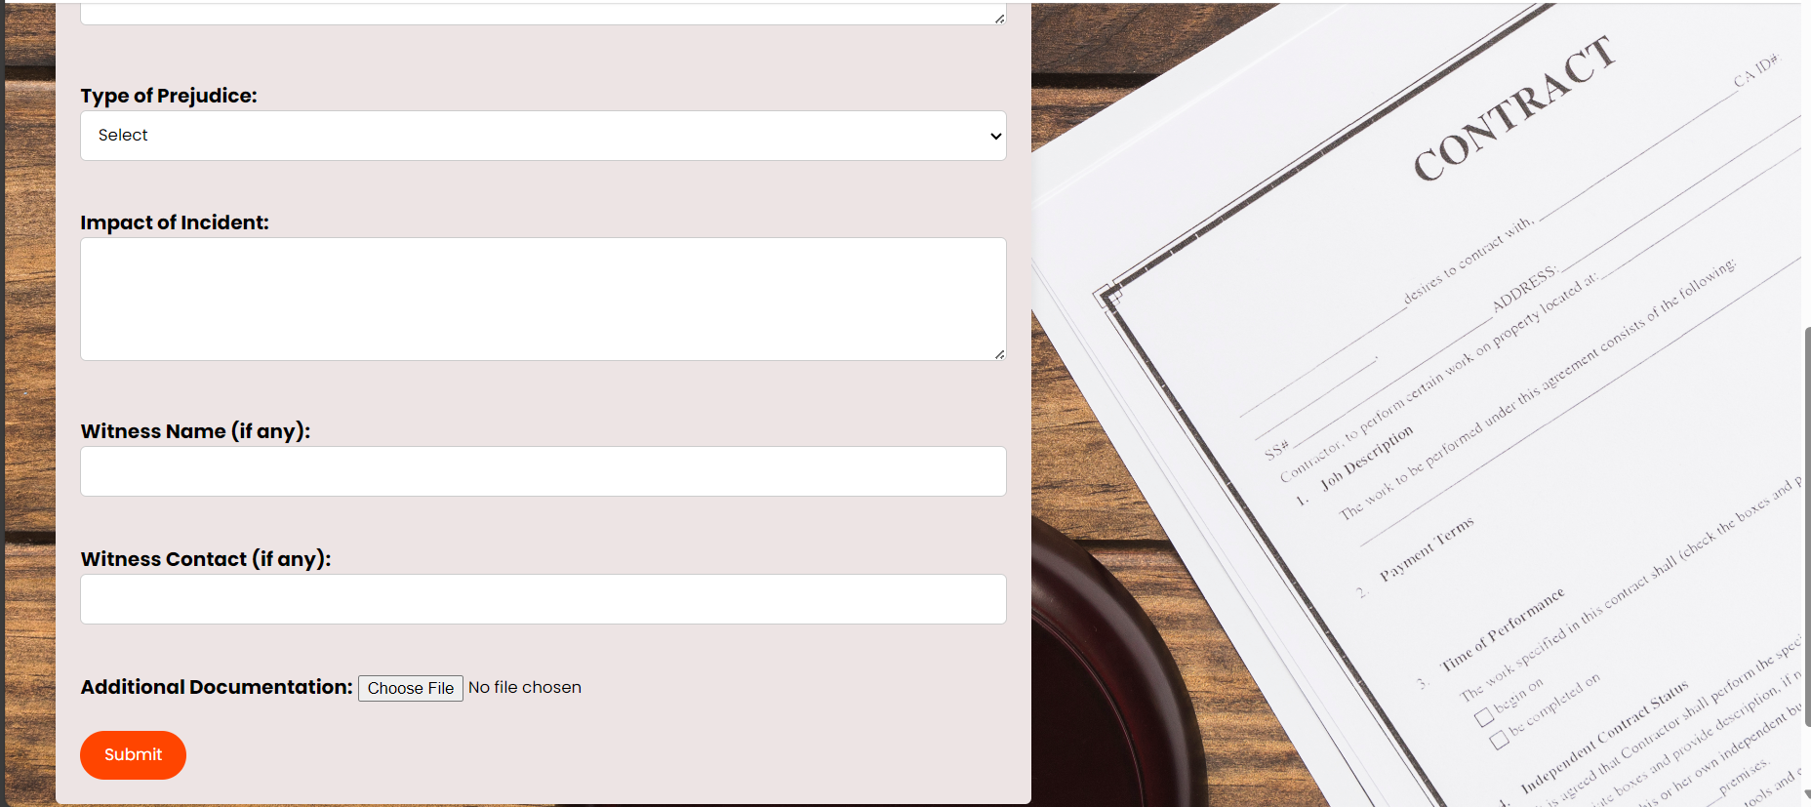
Reporting Form

Slide 12
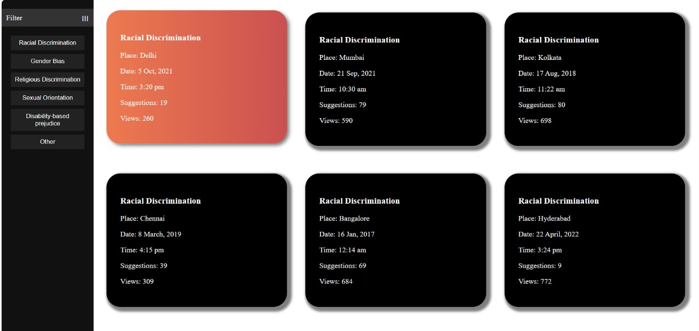
History

Slide 13
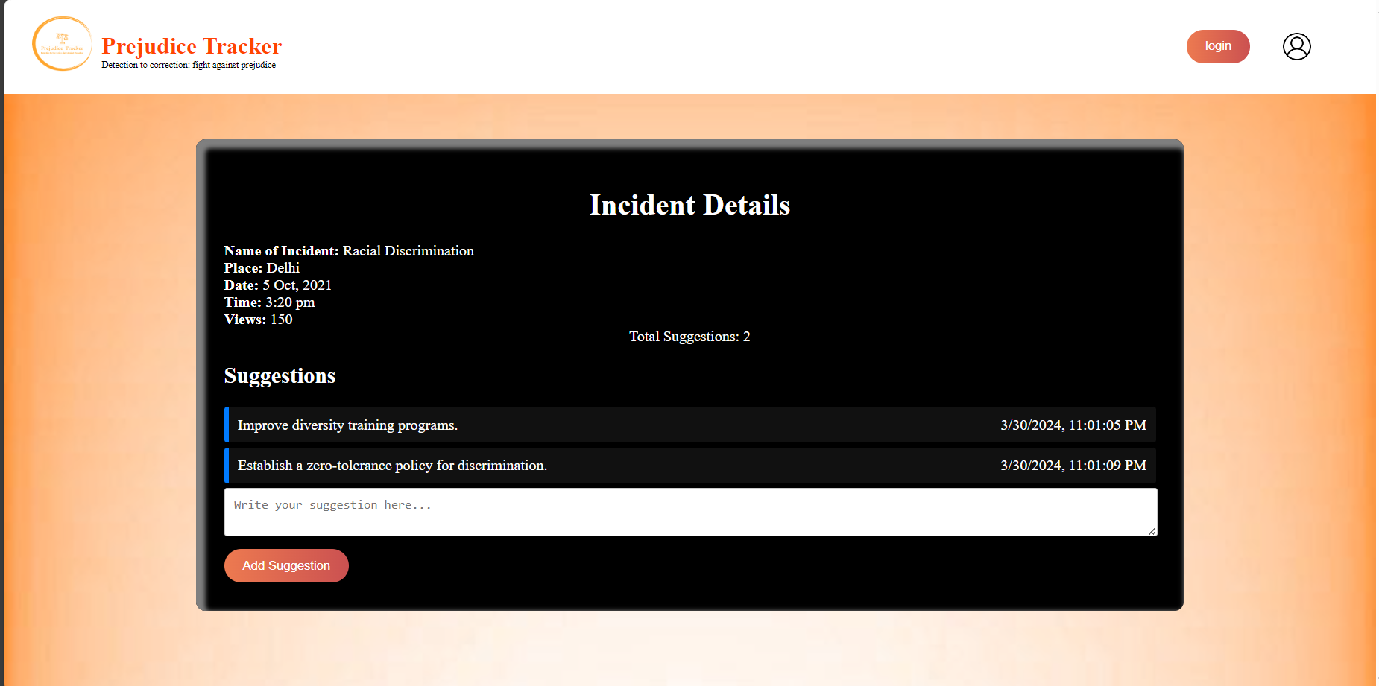
Incident Details and Suggestions

Slide 14
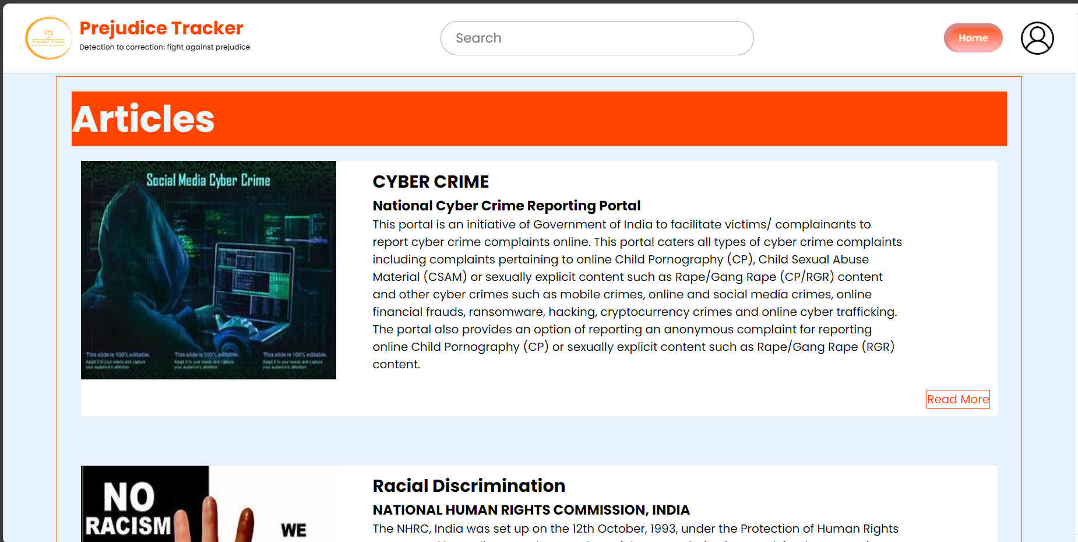
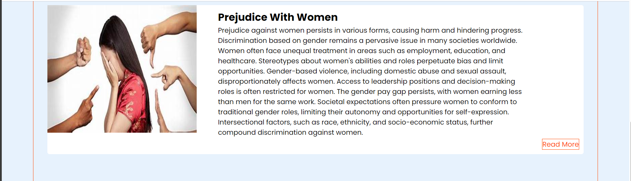
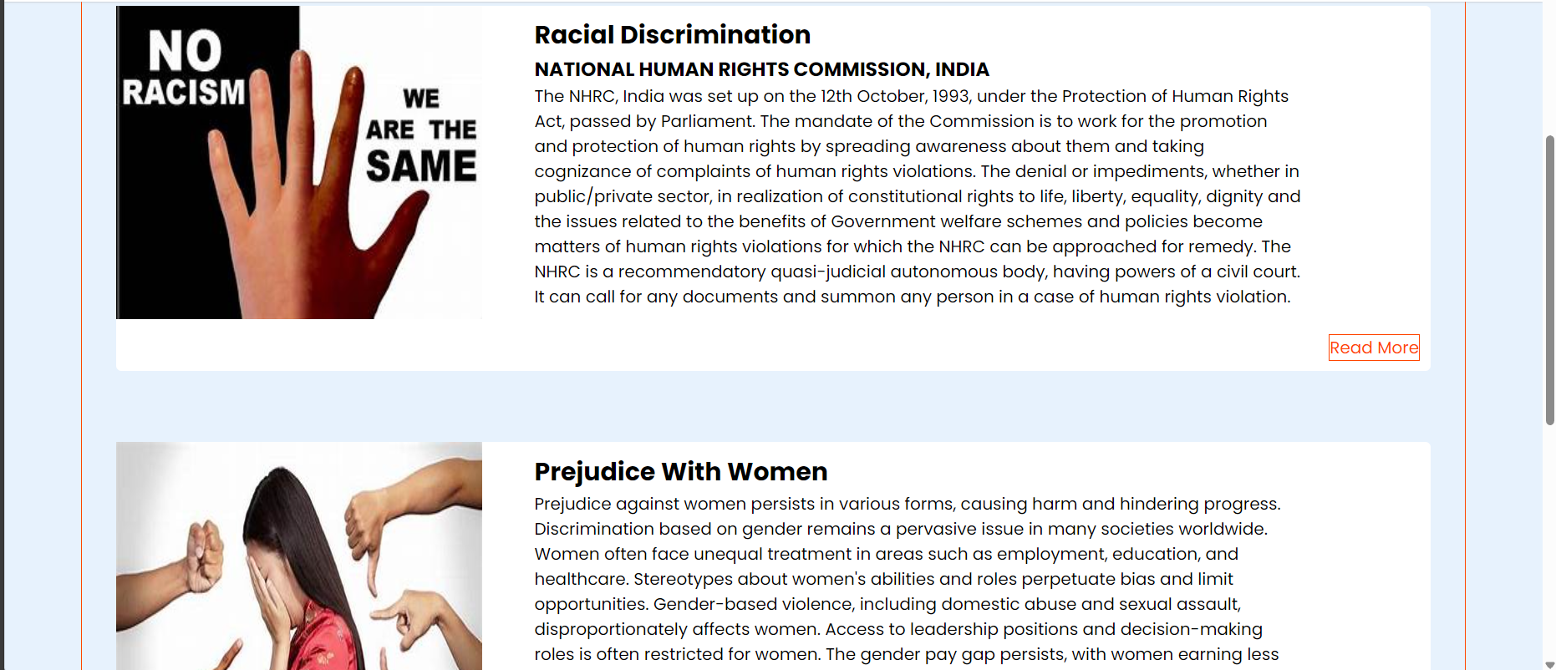
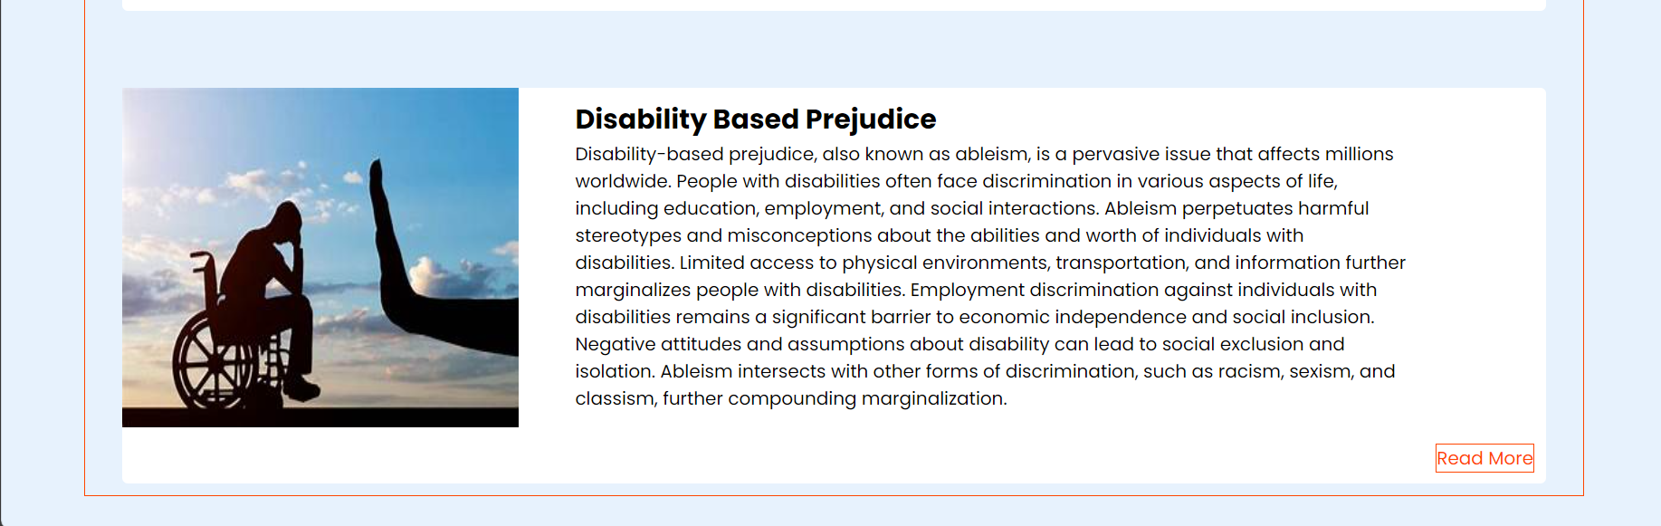
Learning Resources

Slide 15
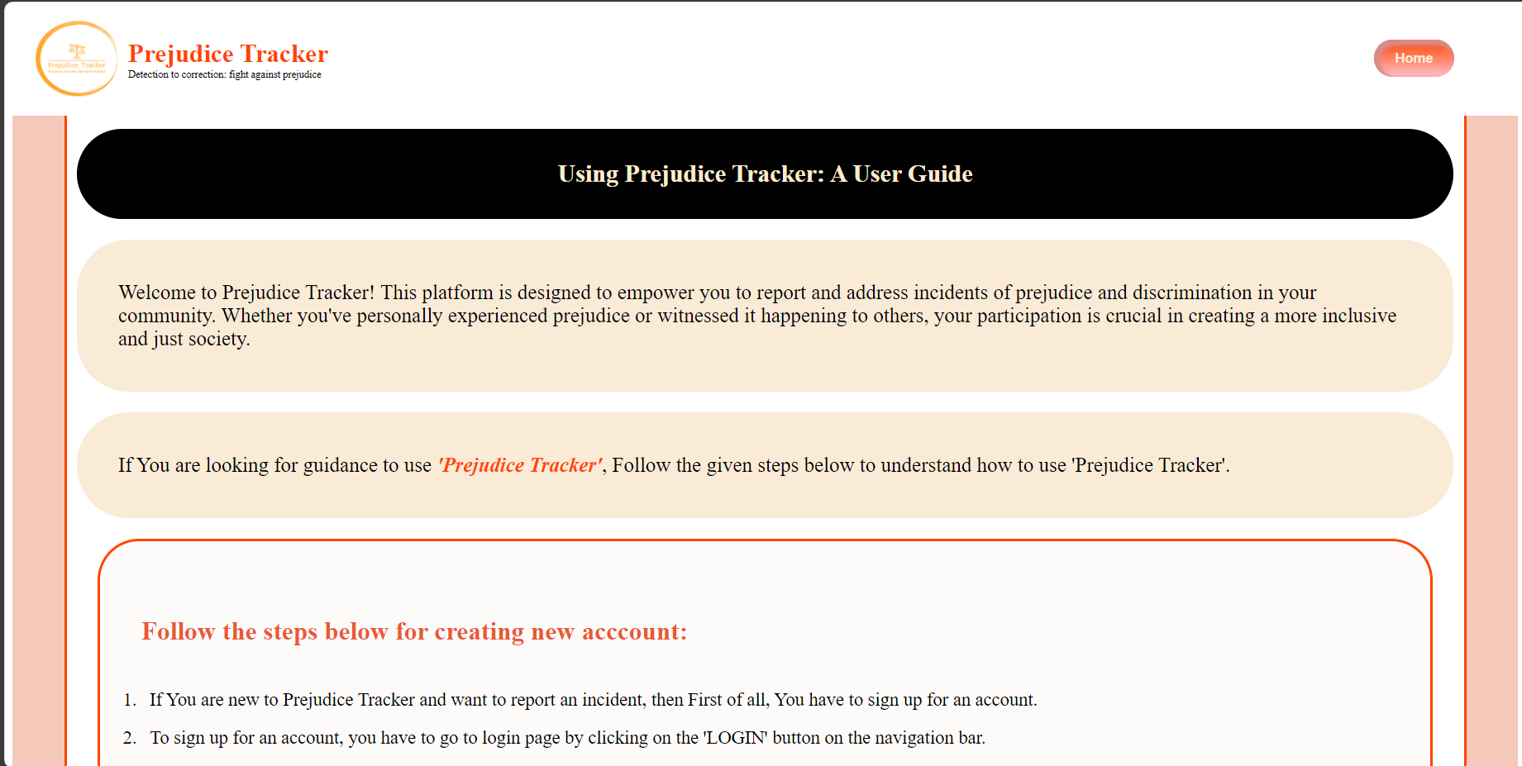
User Guide

Slide 16
CONCLUSION
In wrapping up, our experience with the Prejudice Tracker has opened our eyes to the reality of bias and discrimination. We've learned a lot about how unfair treatment can happen and how we can fix it. But we know there's still more to do.
This tool isn't just about spotting problems; it's about doing something about them. It's about speaking up and making changes to make things better for everyone.
So, as we keep moving forward, let's stay brave and determined. Let's use what we've learned to keep fighting against prejudice. Together, we can make a world where everyone is valued and accepted, no matter who they are.

Slide 17


